Slide 1
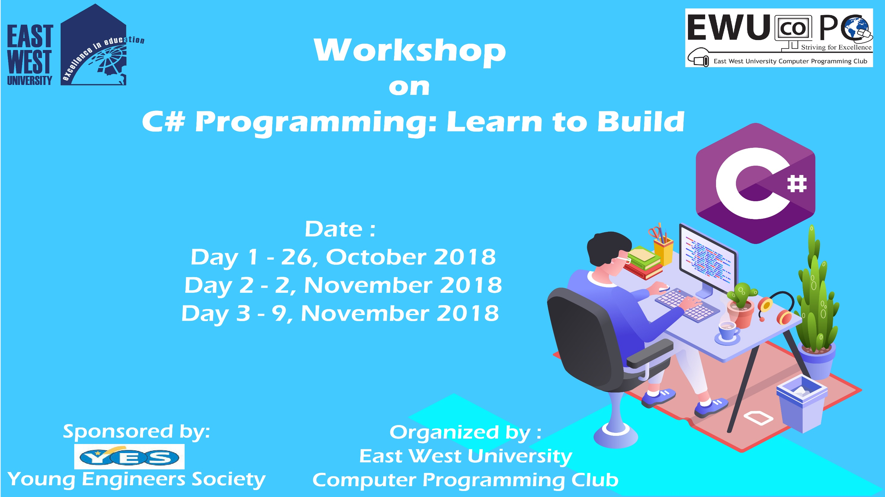

Slide 2
C# Day 3 Lecture15: Database Connection

Slide 3
Database Connection

Slide 4
private void Connection_Click(object sender, EventArgs e)
{
string insertQuery = "INSERT INTO sql12264230.homeTest(name,Value) VALUES('" + this.textBox1.Text + "','" + this.textBox2.Text + "')";
string connectionString = "SERVER=sql12.freesqldatabase.com;PORT=3306;DATABASE=sql12264230;UID=sql12264230;PASSWORD=idUIgb33Gm";
MySqlConnection connection = new MySqlConnection(connectionString);
try
{
connection.Open();
MessageBox.Show("connected");
MySqlCommand com = new MySqlCommand(insertQuery,connection);
try
{
if (com.ExecuteNonQuery() == 1)
{
MessageBox.Show("Data Saved");
}
else {
MessageBox.Show("Sorry Try again");
}
}
catch (Exception ex)
{
MessageBox.Show(ex.Message);
}

Slide 5
Authentication

Slide 6
private void button1_Click(object sender, EventArgs e)
{
string connectionString = "SERVER=sql12.freesqldatabase.com;PORT=3306;DATABASE=sql12264230;UID=sql12264230;PASSWORD=idUIgb33Gm";
string creatCommandString = "Insert into sql12264230.testAuth values('"+CreUser.Text+"','"+CrePass.Text+"')";
MySqlConnection creatConn = new MySqlConnection(connectionString);
try
{
creatConn.Open();
MySqlCommand creCommand = new MySqlCommand(creatCommandString, creatConn);
if (creCommand.ExecuteNonQuery() == 1)
{
creatConn.Close();
MessageBox.Show("Account successfully created");
Form1 f1 = new Form1();
this.Hide();
f1.ShowDialog();
}
else {
MessageBox.Show("Sorry Try Again");
creatConn.Close();
}
}
catch (MySql.Data.MySqlClient.MySqlException ex)
{
MessageBox.Show(ex.Message);
}

Slide 7
This slide is provided as a course material in the workshop named “Workshop on C# Programming: Learn to Build”.
Organized by-
East West University Computer Programming Club (EWUCoPC)
Prepared by- Jannat Binta Alam
Campus Ambassador
Young Engineers Society (YES)
E-mail: jannat.cse.ewu@gmail.com

